Slide 1
L7 Convolutional Neural Networks

Slide 2
Neural network architectures
There are many different neural network architectures
The architecture is defined by the type of layers we implement and how layers are connected together.
The neural network shown is known as a feed-forward network (also known as a multilayer perceptron)
Here we have a series of fully-connected layers

Slide 3
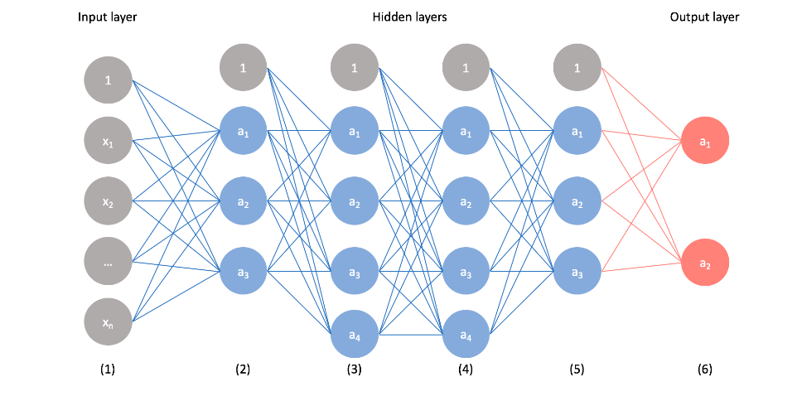
Feed-forward network

Slide 4
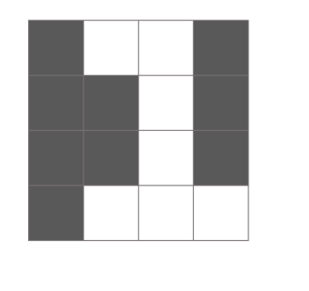
Image recognition
To build a neural network that could recognize handwritten digits
Ex: given the following 4 by 4 pixel image as input, our neural network should classify it as a "1“

Slide 5
Image recognition
Convolutional neural networks are used heavily in image recognition applications of machine learning
Images are a matrix of values corresponding with the intensity of light
white for highest intensity, black for lowest intensity at each pixel value.
Grayscale images have a single value for each pixel
while color images are typically represented by light intensity values for red, green, and blue at each pixel value.
Thus, a 400 by 400 pixel image has the dimensions (400*400*1) for a grayscale image
and for a color image (400*400*3)

Slide 6
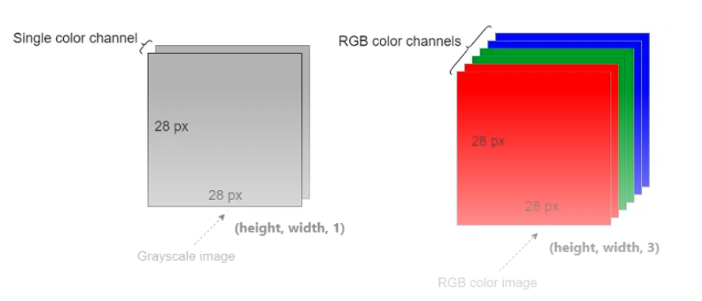
Grayscale vs RGB images

Slide 7
Grayscale vs RGB images
An image consists of pixels and images are represented as arrays of pixel values.
There is only one color channel in a grayscale image. So, a grayscale image is represented as (1, height, width) or simply (height, width).
We can ignore the third dimension because it is one. Therefore, a grayscale image is often represented as a 2D array (tensor).
There are three color channels (Red, Green and Blue) in an RGB image.
So, an RGB image is represented as (3, height, width) as a 3D array (tensor).

Slide 8
Weakness of feedforward networks
1. Cannot directly feed this 2D image into the neural network.
A feed-forward network takes a vector of inputs, so we must flatten our 2D array of pixel values into a vector
But we lose a great deal of information about the picture when we convert the 2D array of pixel values into a vector
Specifically, we lose the spatial relationships within the data.
Identifying the number in a flattened vector form without rearranging the pixels back into a 2D array is difficult
A convolutional neural network (CNN for short) is a special type of neural network model primarily designed to process 2D image data, but which can also be used with 1D and 3D data.
In cases of extremely basic binary images, the method might show an average precision score while performing prediction of classes but would have little to no accuracy when it comes to complex images having pixel dependencies throughout.
2. CNNs can reduce the number of parameters in the network significantly. So, CNNs are parameter efficient.

Slide 9
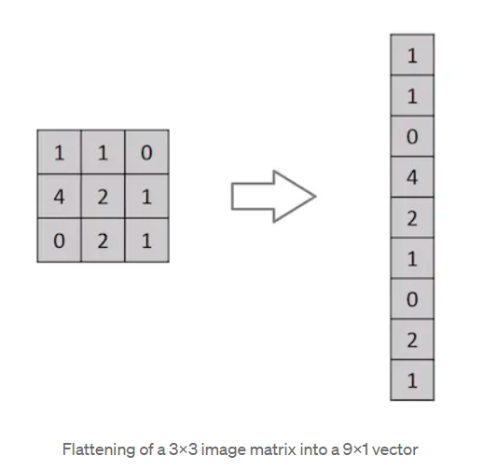
Flattening 2D image into a vector

Slide 10
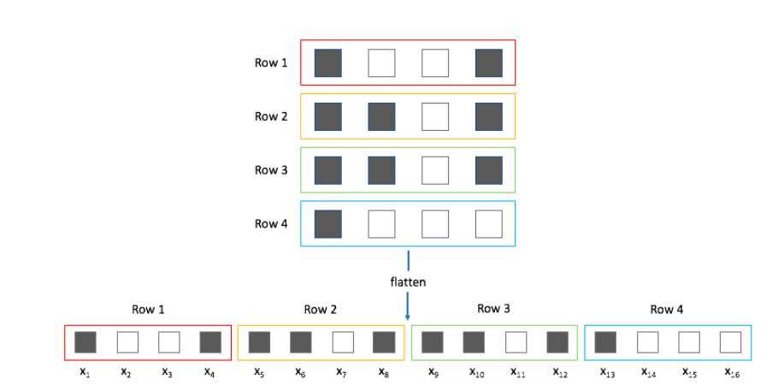
Input to feed-forward network

Slide 11
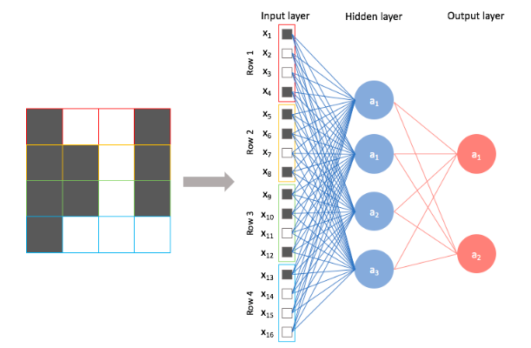
Input to feed-forward network
Now, we can treat each individual pixel value as a feature and feed it into the neural network.

Slide 12
Convolution layers
A convolution layer defines a window
By which we examine a subset of the image, and
Subsequently scans the entire image looking through this window.
We can parameterize the window to look for specific features (e.g. edges) within an image.
This window is also called a filter, since it produces an output image which focuses solely on the regions of the image which exhibited the feature it was searching for.
The output of a convolution is referred to as a feature map
Note: Windows, filters, and kernels all used interchangeably with respect to convolutional neural networks

Slide 13
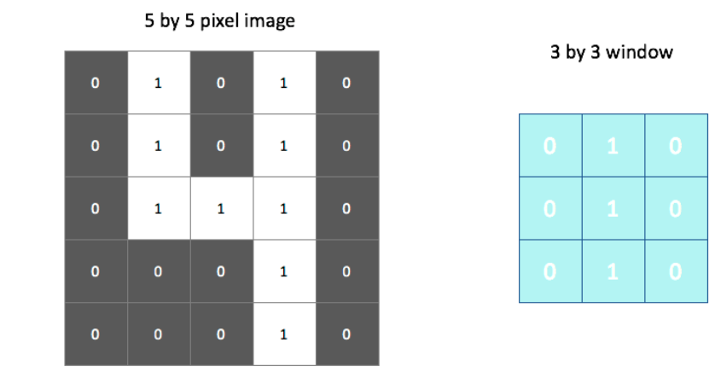
Convolution layers
Ex: the following window searches for vertical lines in the image

Slide 14

Convolution layers
Overlay this filter onto the image and linearly combine the pixel and filter values.
Ex: (0*0)+(1*1)+(0*0)+(0*0)+(1*1)+(0*0)+(0*0)+(1*1)+(0*1) =3
The output, shown on the right, identifies regions of the image in which a vertical line was present.
We could do a similar process using a filter designed to find horizontal edges to properly characterize all of the features of a "4"

Slide 15
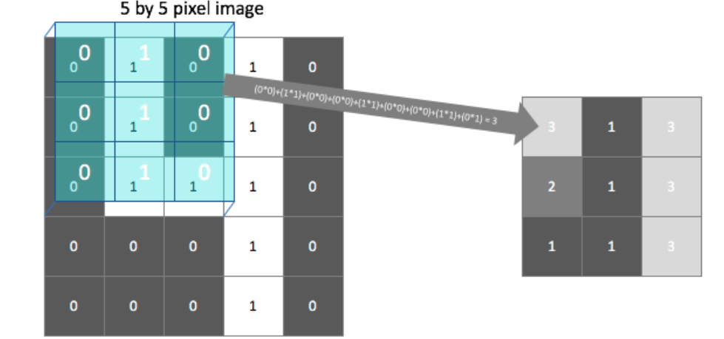
Convolution layers
(0*0)+(1*1)+(0*0)+(0*0)+(1*1)+(0*0)+(0*0)+(1*1)+(0*1) =3

Slide 16
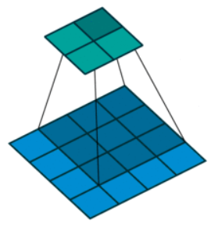
Convolution layers
Scan each filter across the image calculating the linear combination at each step.
In the figure, an input image is represented in blue and the convolved image is represented in green.
We can imagine each pixel in the convolved layer as a neuron which takes all of the pixel values currently in the window as inputs, linearly combined with the corresponding weights in our filter.

Slide 17
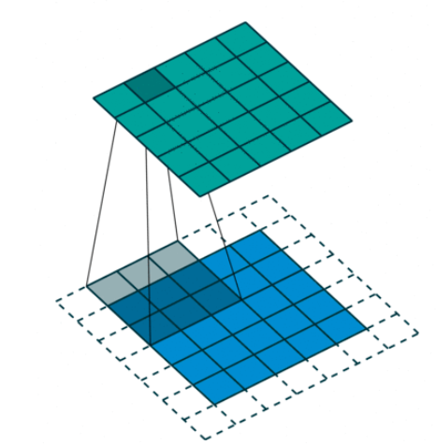
Convolution layers
We can also pad the edges of your images with 0-valued pixels as to fully scan the original image and preserve its complete dimensions

Slide 18
Multiple filters
Note: Although we have hard-coded the filter values for this example, the filter values in a convolutional layer are learned
A typical convolutional layer will apply multiple filters, each of which output a feature mapping of the input signifying the (spatial) locations where a feature is present.
Notice how some feature mappings are more useful than others
in the example next, the "right diagonal" feature mapping, which searches for right diagonals in the image, is essentially a dark image which signifies that the feature is not present

Slide 19
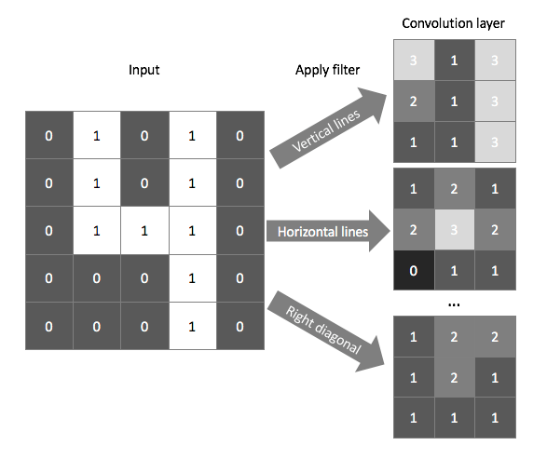
Multiple filters

Slide 20
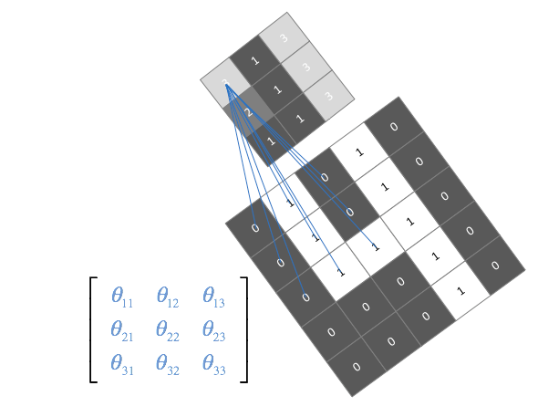
Multiple Filters
In practice, we do not explicitly define the filters that our convolutional layer will use;
we instead parameterize the filters and let the network learn the best filters to use during training.
We do define how many filters we will use at each layer

Slide 21
Multiple Filters
We can stack layers of convolutions together (ie. perform convolutions on convolutions) to learn more intricate patterns within the features mapped in the previous layer.
This allows our neural network to identify general patterns in early layers, then focus on the patterns within patterns in later layers.

Slide 22
Pooling layers
A pooling layer can be used to compress spatial information of our feature mappings.
Here, we still scan across the image using a window, but our goal is to compress information rather than extract certain features.
Similar to convolutional layers, we define the window size, and stride.
Padding is not commonly used for pooling layers.

Slide 23
How Max Pooling Works
Max pooling is performed on the convolutional layers of a CNN.
It involves sliding a window (a filter or kernel) across the input data
Similar to the convolution step, but instead of performing a matrix multiplication, max pooling takes the maximum value within the window.
This maximum value becomes a single pixel in the new, pooled output.
The window is then slid across the input data by a stride of a certain number of pixels, and the process is repeated until the entire input image has been processed.
Typically, the size of the pooling window is 2x2
The stride with which the window is moved is also 2 pixels.
This setup reduces the size of the input by half, both in height and width, effectively reducing the total number of pixels by 50% with a slide of 2.
Ex: Stride=1: means that the filter will move 1 pixel at a time as we slide around

Slide 24
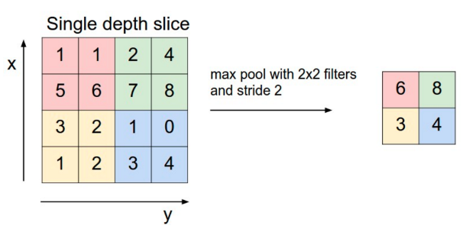
How Max Pooling Works
Here, the input image is 4×4 and the Max-pooling operation is performed using a 2×2 pooling kernel and with stride 2X2.
Stride defines how many numbers of pixels will shift over the input image.

Slide 25
How Max Pooling Works
Max pooling is a downsampling technique to reduce the spatial dimensions of an input volume.
It is a form of non-linear down-sampling to reduce the number of parameters and computation in the network.
The pooling layer is used to reduce the spatial dimensions (i.e., the width and height) of the feature maps, while preserving the depth (i.e., the number of channels)

Slide 26
Advantages of Max Pooling
Feature Invariance or Local Translation invariance: This means that the position of an object in the image does not affect the classification result, as the same features are detected regardless of the position of the object.
Max pooling helps the model to become invariant to the location and orientation of features. This means that the network can recognize an object in an image no matter where it is located.
Dimensionality Reduction: By downsampling the input, max pooling significantly reduces the number of parameters and computations in the network, thus speeding up the learning process and reducing the risk of overfitting.
Noise Suppression: Max pooling helps to suppress noise in the input data. By taking the maximum value within the window, it emphasizes the presence of strong features and diminishes the weaker ones.

Slide 27
Challenges with Max Pooling
Information loss: One of the main disadvantages of pooling layers is that they discard some information from the input feature maps, which can be important for the final classification or regression task.
Over-smoothing: Pooling layers can also cause over-smoothing of the feature maps, which can result in the loss of some fine-grained details that are important for the final classification or regression task.
Hyperparameter tuning: Pooling layers also introduce hyperparameters such as the size of the pooling regions and the stride, which need to be tuned in order to achieve optimal performance. This can be time-consuming and requires some expertise in model building.
Max pooling is a fixed operation and does not learn from the data, unlike convolutional layers that have learnable parameters.
Note: Modern CNN architectures have started to move away from traditional max pooling layers, using alternatives like strided convolutions for downsampling or incorporating learnable pooling operations that can adapt to the data

Slide 28
CNN Tensor Input Shape And Feature Maps
To build a convolutional neural network (CNN), look at a tensor input for a CNN
Consider an image input as a tensor to a CNN.
Shape of A CNN Input - The shape of a CNN input typically has a length of four.
This means that we have a rank-4 tensor with four axes
[Batch, Channels, Height, Width]
It is common to see the B replaced by an N - N standing for number of samples in a batch
PyTorch uses NCHW convention

Slide 29
CNN Tensor Input Shape And Feature Maps
Ex: Interpret the Shape [3, 1, 28, 28] of a given tensor
A batch of three images, each image with a single color channel, and the image height and width are 28 x 28 respectively.
Batch size
Color channels
Height
Width
This gives us a single rank-4 tensor that will ultimately flow through our convolutional neural network
Given a tensor of images like this, we can navigate to a specific pixel in a specific color channel of a specific image in the batch using four indexes

Slide 30
Batch size
Batch size is the number of samples that will be passed through to the network at one time.
Epoch is one single pass over the entire training set to the network.
Batches in Epoch
Suppose we have 1000 images that we want to train our network to identify different breeds.
If we specify our batch size as 10. This means that 10 images will be passed as a group, or as a batch, at one time to the network.
A single epoch is one single pass of all the data through the network
It will take 100 batches to make up full epoch.
We have 1000 images divided by a batch size of 10, which equals 100 total batches.
batches in epoch = training set size / batch_size

Slide 31
Why Use Batches?
batch size is one of the hyperparameters that we must test and tune based on how our specific model is performing during training.
Batch size has to be tested to check how our machine is performing in terms of its resource utilization when using different batch sizes.
Ex: if we set batch size to a relatively high number, say 100, then our machine may not have enough computational power to process all 100 images in parallel, and this would suggest that we need to lower our batch size.

Slide 32
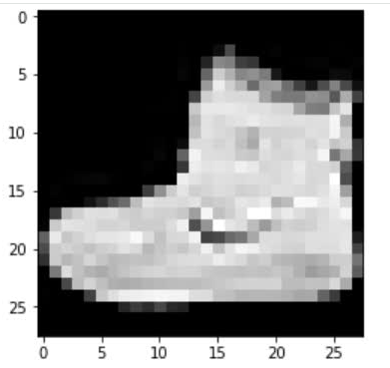
Image Height And Width
To represent two dimensions, we need two axes.
The image height and width are represented on the last two axes.
Possible values here are 28 x 28, for image data in the MNIST or fashion-MNIST dataset

Slide 33
Image Color Channels
The 2nd axis represents the color channels.
Typical values here are 3 for RGB images, 1 for grayscale images.
This color channel interpretation only applies to the input tensor.
Interpretation of this axis changes after the tensor passes through a convolutional layer.

Slide 34
Image Batches
The first axis of the four represents the batch size.
In neural networks, we usually work with batches of samples opposed to single samples
so the length of this axis tells us how many samples are in our batch

Slide 35
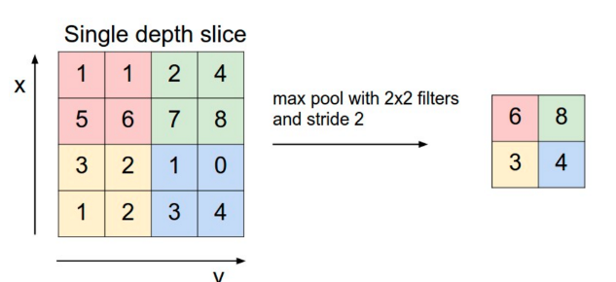
Problem Statement 1 - Implement maxpooling
Ex: A tensor that contains data from a single 28 x 28 grayscale image.
So the tensor shape: [1, 1, 28, 28]
Implement maxpooling for the following input image 4×4 and the Max-pooling operation is performed using a 2×2 pooling kernel and stride 2X2

Slide 36
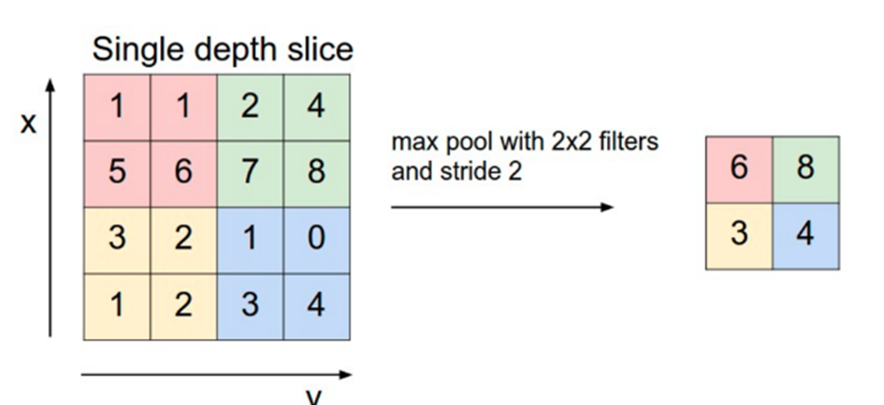
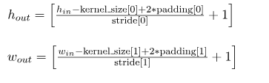
How to compute the output shape
Let the input tensor be of a shape (n, c, h_{in}, w_{in})
Let kernel size is (k_h, k_w)
Output shape is (n, c, h_out, w_out)
The output height and width is
Apply to the Problem Statement 1 and get the output shape

Slide 37
MaxPool2d Operation for max pooling
Syntax :
torch.nn.MaxPool2d(kernel_size, stride=None, padding=0, dilation=1, return_indices=False, ceil_mode=False)
kernel_size : the filtered kernel shape,
stride : Number of pixel shift over the input feature,(default is kernel_size)
padding : Extra 0 padding layers around both side the feature, (default is 0)
dialation: Control the stride (default is 1)
return_indices : True or False (default is False) return the max indices.
ceil_mode : True or False (default is False) when True it will use ceil instead of floor.

Slide 38
Problem Statement 1 - Implement maxpooling
import torch
import torch.nn as nn
# Define the input tensor
input_tensor = torch.tensor(
[
[1, 1, 2, 4],
[5, 6, 7, 8],
[3, 2, 1, 0],
[1, 2, 3, 4]
], dtype = torch.float32)
print("input_tensor shape=", input_tensor.shape)
# Reshape the input_tensor
input_tensor = input_tensor.reshape(1, 1, 4, 4)
print("Reshaped input_tensor shape=", input_tensor.shape)
print("Reshaped input_tensor =", input_tensor)
# Initialize the Max-pooling layer with kernel 2X2 and stride 2
pool = nn.MaxPool2d(kernel_size=2, stride=2)
# Apply the Max-pooling layer to the input tensor
output = pool(input_tensor)
# Print the output tensor
print(output)
print("output shape=", output.shape)

Slide 39
Output
input_tensor shape= torch.Size([4, 4])
Reshaped input_tensor shape= torch.Size([1, 1, 4, 4])
Reshaped input_tensor = tensor([[[[1., 1., 2., 4.],
[5., 6., 7., 8.],
[3., 2., 1., 0.],
[1., 2., 3., 4.]]]])
tensor([[[[6., 8.],
[3., 4.]]]])
output shape= torch.Size([1, 1, 2, 2])

Slide 40
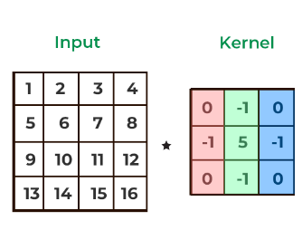

Problem Statement 2- Implement Convolution using torch.nn
Define a custom image of shape 4X4 and kernel 3X3 and bias 1X1

Slide 41
Conv2D function
torch.nn.Conv2d(in_channels, out_channels, kernel_size, stride=1, padding=0, dilation=1, groups=1, bias=True, padding_mode=’zeros’, device=None, dtype=None)
in_channels (int) – Number of channels in the input image. Refers to depth of input image, for a grayscale image the depth = 1
out_channels (int) – Number of channels produced by the convolution. Refers to the desired depth of output
kernel_size (int or tuple) – Size of the convolving kernel.
bias (bool, optional) – If True, adds a learnable bias to the output. Default: True.
stride : controls the stride for the cross-correlation, a single number or a tuple.
padding : controls the amount of padding applied to the input. It can be either a string {‘valid’, ‘same’} or a tuple of ints giving the amount of implicit padding applied on both sides.
dilation : controls the spacing between the kernel points; also known as the à trous algorithm. It is harder to describe, but this link has a nice visualization of what dilation does.
groups : controls the connections between inputs and outputs. in_channels and out_channels must both be divisible by groups.

Slide 42
nn. Parameter
The `torch.nn. Parameter` class in Python's PyTorch library is a subclass of the `torch.Tensor` class.
It represents a learnable parameter in a neural network model.
Instances of this class are used to define trainable model parameters such as weights and biases.
By default, these parameters are automatically registered as model parameters when assigned as attributes to a `torch.nn.Module`.
Parameters can be accessed as attributes of the module and are optimized during the model's training process to minimize a given loss function.
conv = nn.Conv2d(in_channels=1, out_channels=1, kernel_size=3, bias=True)
conv.weight = nn.Parameter(kernel)
conv.bias = nn.Parameter(bias)
output = conv(image)

Slide 43
Problem Statement 2- Implement Convolution using torch.nn
import torch
import torch.nn as nn
import torch.nn.functional as F
# Define the filter
kernel = torch.tensor(
[[0, -1, 0],
[-1, 5, -1],
[0, -1, 0]], dtype=torch.float32)
kernel = kernel.reshape(1, 1, 3, 3)
# Define the bias
bias = torch.tensor([5], dtype=torch.float32)
# Define the input image
image = torch.tensor(
[[1, 2, 3, 4],
[5, 6, 7, 8],
[9, 10, 11, 12],
[13, 14, 15, 16]], dtype=torch.float32)
# Define the convolution operation
conv = nn.Conv2d(in_channels=1, out_channels=1, kernel_size=3, bias=True)
# Set the filter for the convolution
conv.weight = nn.Parameter(kernel)
conv.bias = nn.Parameter(bias)
# Apply the convolution operation
output = conv(image)
print('Output Shape :',output.shape) print('Output \n',output)

Slide 44
Output – Verify the result
Output Shape : torch.Size([1, 1, 2, 2])
Output
tensor([[[[11., 12.],
[15., 16.]]]], grad_fn=<ConvolutionBackward0>)

Slide 45
conv2d from nn.functional and Conv2d from nn
import torch.nn.functional as F
F.conv2d(image, kernel, stride=1, padding=0)
import torch.nn as nn
conv = nn.Conv2d(in_channels=1, out_channels=1, kernel_size=3, bias=True)

Slide 46
Problem Statement 3- Implement Convolution using torch.nn.functional
import torch
import torch.nn.functional as F
image = torch.rand(6,6)
print("image=", image)
#Add a new dimension along 0th dimension
#i.e. (6,6) becomes (1,6,6). This is because
#pytorch expects the input to conv2D as 4d tensor
image = image.unsqueeze(dim=0)
print("image.shape=", image.shape)
image = image.unsqueeze(dim=0)
print("image.shape=", image.shape)
print("image=", image)
kernel = torch.ones(3,3)
#kernel = torch.rand(3,3)
print("kernel=", kernel)
kernel = kernel.unsqueeze(dim=0)
kernel = kernel.unsqueeze(dim=0)
#Perform the convolution
outimage = F.conv2d(image, kernel, stride=1, padding=0)
print("outimage=", outimage)

Slide 47
Problem Statement 3- Implement Convolution using torch.nn.functional – Verify the Output
image= tensor([[0.6868, 0.2533, 0.0259, 0.4412, 0.4339, 0.9242],
[0.9915, 0.4162, 0.6781, 0.2680, 0.1099, 0.2549],
[0.8064, 0.5468, 0.0398, 0.8435, 0.1475, 0.5481],
[0.8009, 0.8932, 0.8112, 0.8710, 0.2113, 0.3962],
[0.3849, 0.0399, 0.6809, 0.3007, 0.6260, 0.3822],
[0.4638, 0.7756, 0.4571, 0.7085, 0.6496, 0.9681]])
image.shape= torch.Size([1, 6, 6])
image.shape= torch.Size([1, 1, 6, 6])
image= tensor([[[[0.6868, 0.2533, 0.0259, 0.4412, 0.4339, 0.9242],
[0.9915, 0.4162, 0.6781, 0.2680, 0.1099, 0.2549],
[0.8064, 0.5468, 0.0398, 0.8435, 0.1475, 0.5481],
[0.8009, 0.8932, 0.8112, 0.8710, 0.2113, 0.3962],
[0.3849, 0.0399, 0.6809, 0.3007, 0.6260, 0.3822],
[0.4638, 0.7756, 0.4571, 0.7085, 0.6496, 0.9681]]]])
kernel= tensor([[1., 1., 1.],
[1., 1., 1.],
[1., 1., 1.]])
outimage= tensor([[[[4.4446, 3.5127, 2.9878, 3.9712],
[5.9840, 5.3677, 3.9803, 3.6504],
[5.0041, 5.0271, 4.5320, 4.3265],
[5.3076, 5.5382, 5.3163, 5.1136]]]])

Slide 48
Problem Statement 4- Using nn. Conv2d and F. conv2d – verify the output
import torch
import torch.nn.functional as F
import torch.nn as nn
filter = torch.tensor(
[[0, -1, 0],
[-1, 5, -1],
[0, -1, 0]], dtype=torch.float32)
filter = filter.reshape(1, 1, 3, 3)
inputs = torch.tensor(
[[1, 2, 3, 4],
[5, 6, 7, 8],
[9, 10, 11, 12],
[13, 14, 15, 16]], dtype=torch.float32)
inputs = inputs.reshape(1, 1, 4, 4)
print("filter=", filter)
print("inputs=", inputs)
o1=F.conv2d(inputs, filter, padding=0, bias=None)
print("F.conv2d output=", o1)
# using nn.Conv2d
conv = nn.Conv2d(1,1,kernel_size=3,padding=0, bias=False)
conv.weight = nn.Parameter(filter)
o2=conv(inputs)
print("nn.Conv2d output=", o2)

Slide 49
Problem Statement 4- Using nn. Conv2d and F. conv2d – verify the output
filter= tensor([[[[ 0., -1., 0.],
[-1., 5., -1.],
[ 0., -1., 0.]]]])
inputs= tensor([[[[ 1., 2., 3., 4.],
[ 5., 6., 7., 8.],
[ 9., 10., 11., 12.],
[13., 14., 15., 16.]]]])
F.conv2d output= tensor([[[[ 6., 7.],
[10., 11.]]]])
nn.Conv2d output= tensor([[[[ 6., 7.],
[10., 11.]]]], grad_fn=<ConvolutionBackward0>)

Slide 50
Architecture of a Convolutional Neural Network
A typical CNN architecture consists of multiple layers, each serving a specific purpose in the image classification task.
1. The architecture begins with an input layer that takes in the image data.
2. This is followed by convolutional layers, which apply convolutional filters to the input image to extract features.
Activation functions are then applied to introduce non-linearity into the features.
Pooling layers are used to downsample the feature maps and reduce computational costs.
Convolutional Neural Network consists of multiple layers like the input layer, Convolutional layer, Activation functions, Pooling layer, and followed by fully connected layers and output layer

Slide 51
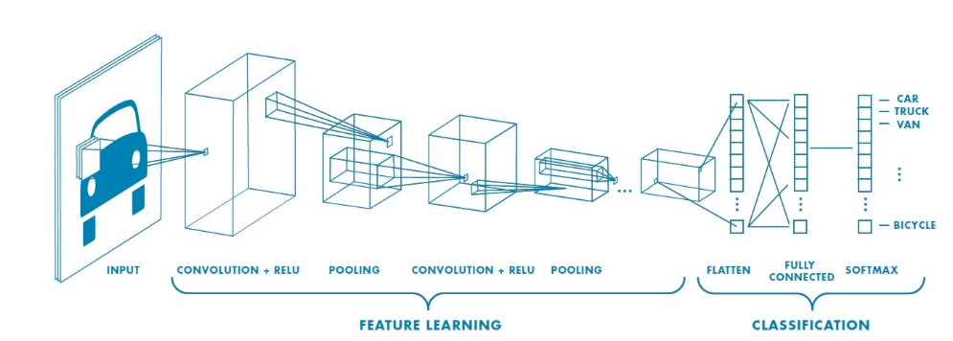
Architecture of a Convolutional Neural Network

Slide 52
CNN Basic Architecture
There are two main parts to a CNN architecture
A convolution layer that separates and identifies the various features of the image for analysis in a process called as Feature Extraction.
The network of feature extraction consists of many pairs of convolutional layers.
A fully connected layer that utilizes the output from the convolution process and predicts the class of the image based on the features extracted in previous stages.
This CNN model of feature extraction aims to reduce the number of features present in a dataset.
It creates new features which summarises the existing features contained in an original set of features.

Slide 53
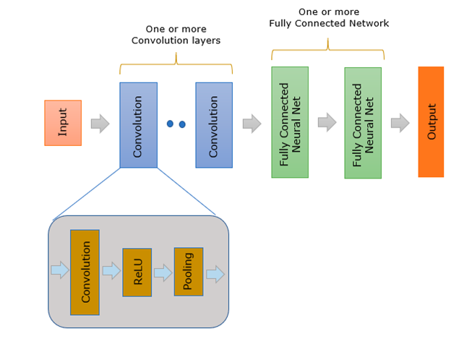
Architecture of a Convolutional Neural Network

Slide 54
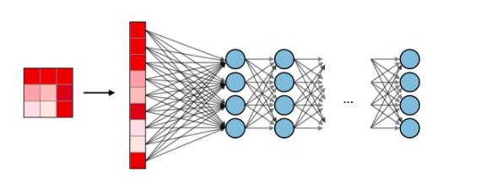
A fully connected layer
Fully Connected (FC): A fully connected layer (FC) operates on a flattened input where each input is connected to all neurons.
FC layers are towards the end of CNN architectures and can be used to optimize objectives such as class scores.

Slide 55
Implementing a Convolutional Neural Network in PyTorch
Load MNIST dataset using the PyTorch datasets module.
Define the necessary parameters, including the number of epochs and learning rate.
Next, create the architecture of our CNN model by defining the layers, such as convolutional layers, pooling layers, and fully connected layers.
Finally, train the CNN model using a training loop, optimizing the model parameters using stochastic gradient descent.
After training the CNN model, evaluate its performance on the test data.
Calculate the accuracy of the total network as well as the accuracy for each individual class.

Slide 56
CALCULATING THE NUMBER OF PARAMETERS IN CNN
We have the same general setup for the number of learnable parameters in CNN similar to FFNN
Calculate the number of parameters per layer, and then sum up the parameters in each layer to get the total amount of learnable parameters in the entire network
For one layer:
i - no. of input channels
f - filter size (just the length)
o - no. of output channels. this is also defined by how many filters are used. One filter is applied to every input channel
num_params = weights + biases
= size of kernel *( in_channels * out_channels)+out_channels
= (f*f)*( i * o) + o
Note: In CNN, total number of kernels is unknown.

Slide 57
CALCULATING THE NUMBER OF PARAMETERS IN CNN
Ex 1: Greyscale image with 2×2 filter, output 3 channels. Find weights and biases.

Slide 58
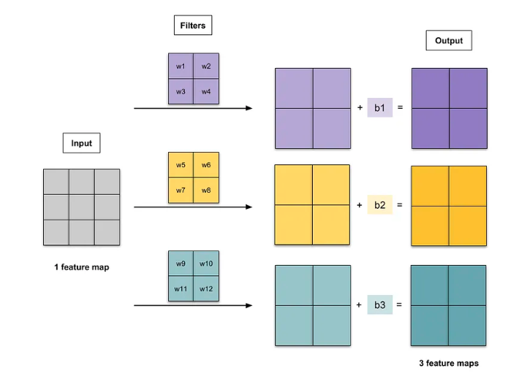
CALCULATING THE NUMBER OF PARAMETERS IN CNN
Ex 1: Greyscale image with 2×2 filter, output 3 channels. Find weights and biases.

Slide 59
CALCULATING THE NUMBER OF PARAMETERS IN CNN
Ex 1: Greyscale image with 2×2 filter, output 3 channels. Find weights and biases.
i = 1 (greyscale has only 1 channel), f = 2, o = 3
num_params = (f*f)*( i * o) + o = (2×2)* (1× 3) + 3= 12+3=15
12 weights and 3 biases

Slide 60
CALCULATING THE NUMBER OF PARAMETERS IN CNN
Ex 2: RGB image with 2×2 filter, output of 1 channel. Find weights and biases.

Slide 61
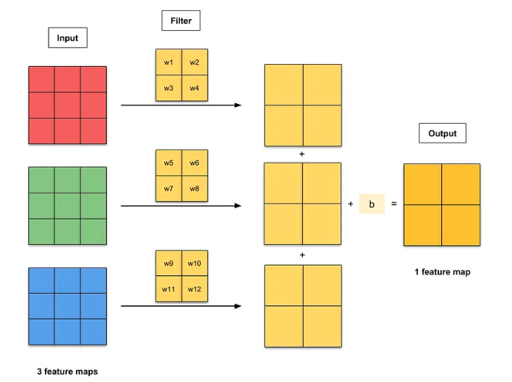
CALCULATING THE NUMBER OF PARAMETERS IN CNN
Ex 2: RGB image with 2×2 filter, output of 1 channel. Find weights and biases.
There is 1 filter for each input feature map.
The resulting convolutions are added element-wise, and a bias term is added to each element.
This gives an output with 1 feature map

Slide 62
CALCULATING THE NUMBER OF PARAMETERS IN CNN
Ex 2: RGB image with 2×2 filter, output of 1 channel. Find weights and biases.
i = 3 (RGB image has 3 channels)
f = 2
o = 1
num_params
= (f*f)*( i * o) + o
= (2×2) × (3 × 1) + 1
= 12+1
12 weights and 1 bias

Slide 63
CALCULATING THE NUMBER OF PARAMETERS IN CNN
Ex 3: Image with 2 channels, with 2×2 filter, and output of 3 channels. Find weights and biases

Slide 64
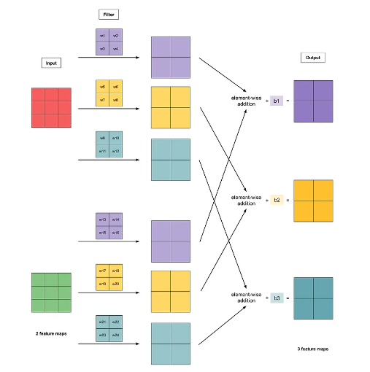
CALCULATING THE NUMBER OF PARAMETERS IN CNN
Ex 3: Image with 2 channels, with 2×2 filter, and output of 3 channels. Find weights and biases
There are 3 filters for each input feature map.
The resulting convolutions are added element-wise, and a bias term is added to each element.
This gives an output with 3 feature maps.

Slide 65
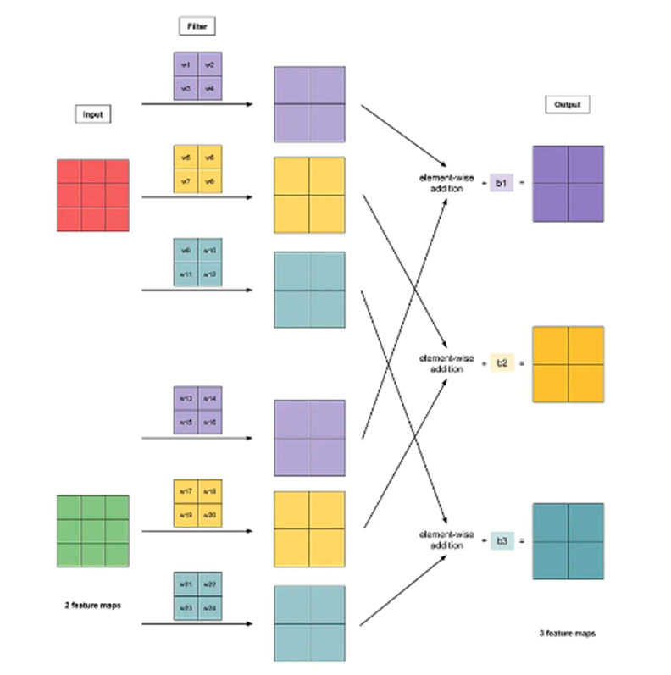
CALCULATING THE NUMBER OF PARAMETERS IN CNN
Ex 3: Image with 2 channels, with 2×2 filter, and output of 3 channels. Find weights and biases
i = 2
f = 2
o = 3
num_params
= (f*f)*( i * o) + o
= (2×2) × (2 × 3) + 3
= 24+ 3
= 27
24 weights and 3 biases

Slide 66
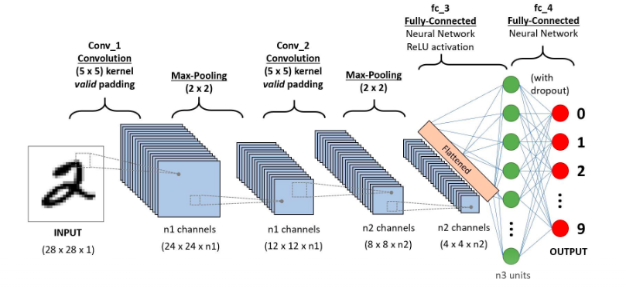
Skeleton Architecture - MNIST Digit Classification using CNN
Note:When defining CNN architecture, activation layer could be omitted.
However, the activation layers are implicitly assumed to be part of the architecture.

Slide 67
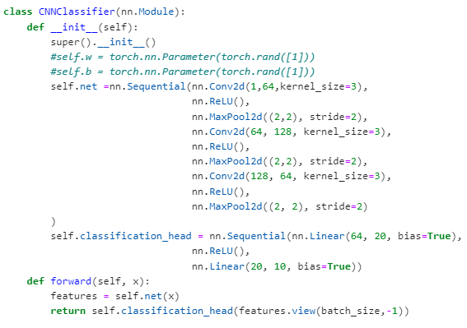
MNIST Digit Classification using CNN – Verify total number of parameters

Slide 68
MNIST Digit Classification using CNN
Note: In the forward method, define the sequence.
Before the fully connected layers, reshape the output to match the input to a fully connected layer

Slide 69
MNIST Digit Classification using CNN - Output
CNNClassifier(
(net): Sequential(
(0): Conv2d(1, 64, kernel_size=(3, 3), stride=(1, 1))
(1): ReLU()
(2): MaxPool2d(kernel_size=(2, 2), stride=2, padding=0, dilation=1, ceil_mode=False)
(3): Conv2d(64, 128, kernel_size=(3, 3), stride=(1, 1))
(4): ReLU()
(5): MaxPool2d(kernel_size=(2, 2), stride=2, padding=0, dilation=1, ceil_mode=False)
(6): Conv2d(128, 64, kernel_size=(3, 3), stride=(1, 1))
(7): ReLU()
(8): MaxPool2d(kernel_size=(2, 2), stride=2, padding=0, dilation=1, ceil_mode=False)
)
(classification_head): Sequential(
(0): Linear(in_features=64, out_features=20, bias=True)
(1): ReLU()
(2): Linear(in_features=20, out_features=10, bias=True)
)
)

Slide 70
MNIST Digit Classification using CNN - Output
CNNClassifier(
(net): Sequential(
(0): Conv2d(1, 64, kernel_size=(3, 3), stride=(1, 1))
(1): ReLU()
(2): MaxPool2d(kernel_size=(2, 2), stride=2, padding=0, dilation=1, ceil_mode=False)
(3): Conv2d(64, 128, kernel_size=(3, 3), stride=(1, 1))
(4): ReLU()
(5): MaxPool2d(kernel_size=(2, 2), stride=2, padding=0, dilation=1, ceil_mode=False)
(6): Conv2d(128, 64, kernel_size=(3, 3), stride=(1, 1))
(7): ReLU()
(8): MaxPool2d(kernel_size=(2, 2), stride=2, padding=0, dilation=1, ceil_mode=False)
)
(classification_head): Sequential(
(0): Linear(in_features=64, out_features=20, bias=True)
(1): ReLU()
(2): Linear(in_features=20, out_features=10, bias=True)
)
)
net.0.weight 576
net.0.bias 64
net.3.weight 73728
net.3.bias 128
net.6.weight 73728
net.6.bias 64
classification_head.0.weight 1280
classification_head.0.bias 20
classification_head.2.weight 200
classification_head.2.bias 10
Total Parameters:149798

Slide 71
CALCULATING THE NUMBER OF PARAMETERS IN CNN
In CNN, the exact type of features to be detected is determined by the network itself during the learning process.
The element values for each of the kernel is not fixed/predefined and is set randomly and gets updated (changes) during learning process.
So, theoretically we can find total number of parameters and number of output channels as shown next examples in Ex1-Ex3.
number of kernels and the kernel size is given,
number of input channels is given,
number of output channels is not given
Note: Number of kernels: This parameter is responsible for defining the depth of the output. If we have three distinct filters, we have three different feature maps, creating a depth of three. Here number of output channels is assumed same as number of kernels

Slide 72
CALCULATING THE NUMBER OF PARAMETERS IN CNN
1. input_shape
input_shape = (batch_size, depth, height, width)
batch_size= number of training examples in one forward/backward pass
2. output_shape
output_shape = (batch_size, depth, height, width)
3. filter
In a convolution neural network, input data is convolved over with a filter which is used to extract features.
Filter/kernel is a matrix that will move over the image pixel data (input) and will perform a dot product with that particular region of that input data and the output will be the matrix of the dot product.

Slide 73
CALCULATING THE NUMBER OF PARAMETERS IN CNN – Ex1
Ex 1:Calculate the number of parameters and output shape
Input:
filters = 1
kernel_size=(3,3)
input_shape=(1, 10,10)

Slide 74
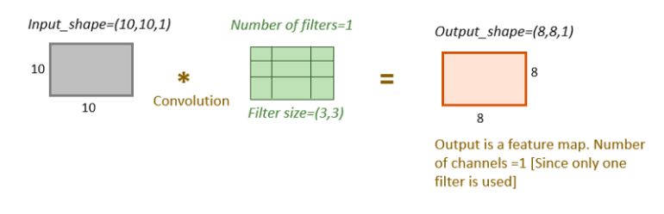
CALCULATING THE NUMBER OF PARAMETERS IN CNN – Ex1
Ex 1: Calculate the number of parameters and output shape
filters = 1
kernel_size=(3,3)
input_shape=(1, 10,10)
Note: Image Processing convention of NHWC (10, 10, 1) and (8, 8, 1)is shown in the diagram.
PyTorch uses NCHW convention of(1, 10, 10), (1, 8, 8)

Slide 75
CALCULATING THE NUMBER OF PARAMETERS IN CNN – Ex1
Ex 1: Calculate the number of parameters and output shape
filters = 1
kernel_size=(3,3)
input_shape=(1, 10,10)
Weights in one filter of size(3,3)= 3*3 =9
Bias =1 [One bias will be added to each filter. Since only one filter kernel is used, bias =1]
Total parameters for one filter kernel of size (3,3) = 9+1 =10 = 3*3*(1*1)+1
Output shape = n-f+1 = 10–3+1 =8
The number of channels in the feature map depends on the number of filters used. Here, in this example, only one filter is used. So, the number of channels in the feature map is 1.
So, Output_shape of feature map= (1, 8,8)

Slide 76
CALCULATING THE NUMBER OF PARAMETERS IN CNN – Ex2
Ex 2:Calculate the number of parameters and output shape
Input:
filters = 5
kernel_size=(3,3)
input_shape=(1, 10,10)

Slide 77
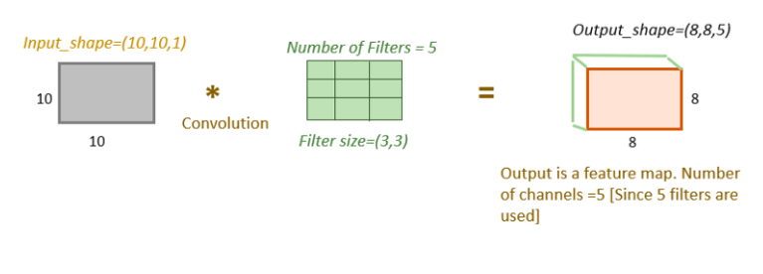
CALCULATING THE NUMBER OF PARAMETERS IN CNN – Ex2
Ex 2: Calculate the number of parameters and output shape
filters = 5
kernel_size=(3,3)
input_shape=(1, 10,10)

Slide 78
CALCULATING THE NUMBER OF PARAMETERS IN CNN – Ex2
Ex 2: Calculate the number of parameters and output shape
filters = 5
kernel_size=(3,3)
input_shape=(1, 10,10)
Parameters in one filter of size(3,3)= 3*3 =9
Bias =1 [One bias will be added to each filter]
Total parameters for filter kernel of size (3,3) = 9+1 =10
The total number of filters= 5.
Total parameters for 5 filter kernel of size (3,3) = 10*5=50 = 3*3*(1*5)+5
Output shape = n-f+1 = 10–3+1 =8
The number of channels in the feature map depends on the number of filters used. Here, in this example, 5 filters are used. So, the number of channels in the feature map is 5.
So, Output_shape of feature map= (5, 8,8)

Slide 79
CALCULATING THE NUMBER OF PARAMETERS IN CNN – Ex3
Ex 3:Calculate the number of parameters and output shape
Input:
filters = 5
kernel_size=(3,3)
input_shape=(3, 10,10)

Slide 80
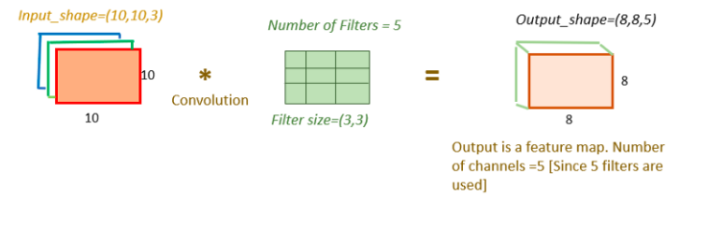
CALCULATING THE NUMBER OF PARAMETERS IN CNN – Ex3
Ex 3: Calculate the number of parameters and output shape
filters = 5
kernel_size=(3,3)
input_shape=(3, 10,10)

Slide 81
CALCULATING THE NUMBER OF PARAMETERS IN CNN – Ex3
Ex 3:Calculate the number of parameters and output shape
filters = 5
kernel_size=(3,3)
input_shape=(3,10,10)
Parameters in one filter of size(3,3)= 3*3 =9
The filter will convolve over all three channels concurrently(input_image depth=3). So parameters in one filter will be 3*3*3=27 [filter size * input_data depth]
Bias =1 [One bias will be added to each filter]
Total parameters for one filter of size (3,3) for depth 3=(3*3*3)+1=28
The total number of filters= 5.
Total parameters for 5 kernel of size (3,3) , input_image depth(3)= 28*5=140 = (3*3)*(3*5)+5
Output shape = n-f+1 = 10–3+1 =8
The number of channels in the feature map depends on the number of filters used. Here, in this example, 5 filters are used. So, the number of channels in the feature map is 5.
So, Output_shape of feature map= (5, 8,8)

Slide 82
CNN Summary
1. Input Layer: Think of it as the ground floor, where the raw image data enters the CNN.
2. Convolutional Layer: This is where the magic happens! Like skilled workers constructing walls, convolutional filters slide across the image, detecting patterns and extracting features.
3. Pooling Layer: This is like a foreman optimizing the construction process. Pooling reduces the image size, making computations faster and reducing memory usage.
4. Activation Layer: This is like adding color and vibrancy to the building. Activation functions introduce non-linearity, allowing the network to learn complex relationships between features.
5. Fully Connected Layer: This is like the top floor, where all the features come together for the final decision. The network takes in the extracted features and classifies the image.
6. Output Layer: This is like the roof, where the final classification result is displayed

